Slide 1
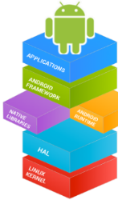

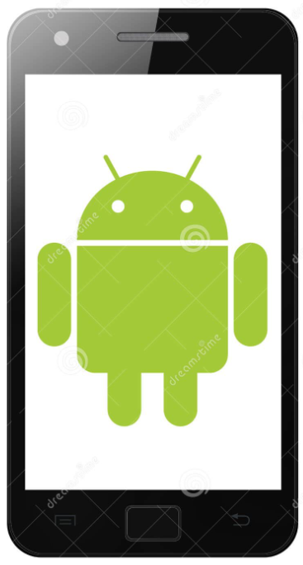

Mobile Application Development (COS7025-B) Designing Mobile Apps using Android
Karim Hammoud Sadik
Lecture #3
Android Studio

Slide 2
Contents
Views, view groups, and view hierarchy
The layout editor and ConstraintLayout
Event handling
Resources and measurements

Slide 3
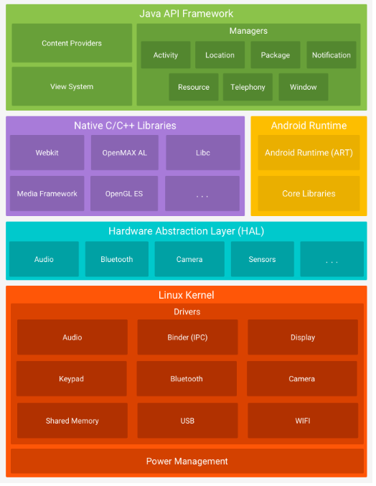

Android Framework
Provides entire feature set to us through APIs written in Java. The APIs are building blocks for creating apps. Features include:
View system
lists, grids, text boxes, buttons, etc.
Content Providers
Inter‐application data sharing
Activity Manager
Application lifecycle and common navigation stack

Slide 4
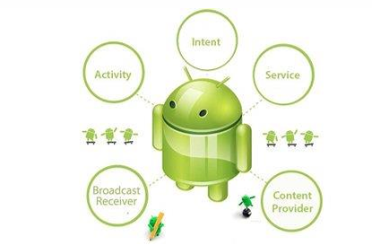
Mobile App Components
App comprises components that the system can instantiate and run as needed. Key component classes include:
Activities
Intent
Services
Broadcast receivers
Content providers

Slide 5
Mobile App Components
Activities
An activity represents a single screen with a user interface. For example, an email app might have one activity that shows a list of new emails, another activity to compose an email, and another activity for reading emails.
An activity is implemented as a subclass of Activity and we will have a whole lecture on Activities in the next session.

Slide 6
Mobile App Components
Services
A service is a component that runs in the background to perform long-running operations or to perform work for remote processes.
A service does not provide a user interface. For example, a service might play music in the background while the user is in a different app, or it might fetch data over the network without blocking user interaction with an activity.
A service is implemented as a subclass of Service and you will learn about services during later sessions.

Slide 7
Mobile App Components
Broadcast Receivers
A broadcast receiver is a component that replies to system-wide broadcast announcements.
Many broadcasts originate from the system—for example, a broadcast announcing that the screen has turned off, the battery is low, or a picture was captured.
Apps can also initiate broadcasts—for example, to let other apps know that some data has been downloaded to the device and is available for them to use.

Slide 8
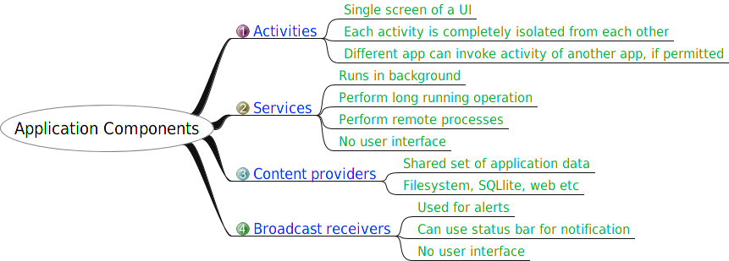
Summary Mobile App Components

Slide 9
There are other Components
Components | Description | When you will learn about them
Views | UI elements that are drawn onscreen including buttons, lists forms etc. | Next few sessions
Layouts | View hierarchies that control screen format and appearance of the views. | Next slides (and other sessions)
Resources | External elements, such as strings, constants and drawables pictures.
Intents | Messages wiring components together.
Manifest | Manifest Configuration file for the application.
Fragments | Represents a behavior or a portion of user interface in an Activity.

Slide 10
Activities
(high-level view)

Slide 11
What is an Activity?
An Activity is an application component
Represents one window, one hierarchy of views
Typically fills the screen, but can be embedded in other Activity or a appear as floating window
Java class, typically one Activity in one file

Slide 12
What does an Activity do?
Represents an activity, such as ordering groceries, sending email, or getting directions
Handles user interactions, such as button clicks, text entry, or login verification
Can start other activities in the same or other apps
Has a life cycle—is created, started, runs, is paused, resumed, stopped, and destroyed

Slide 13
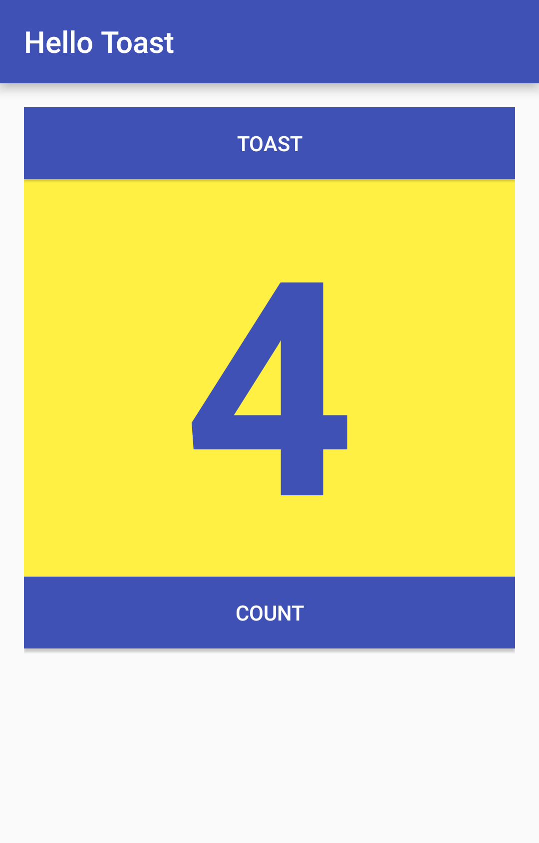
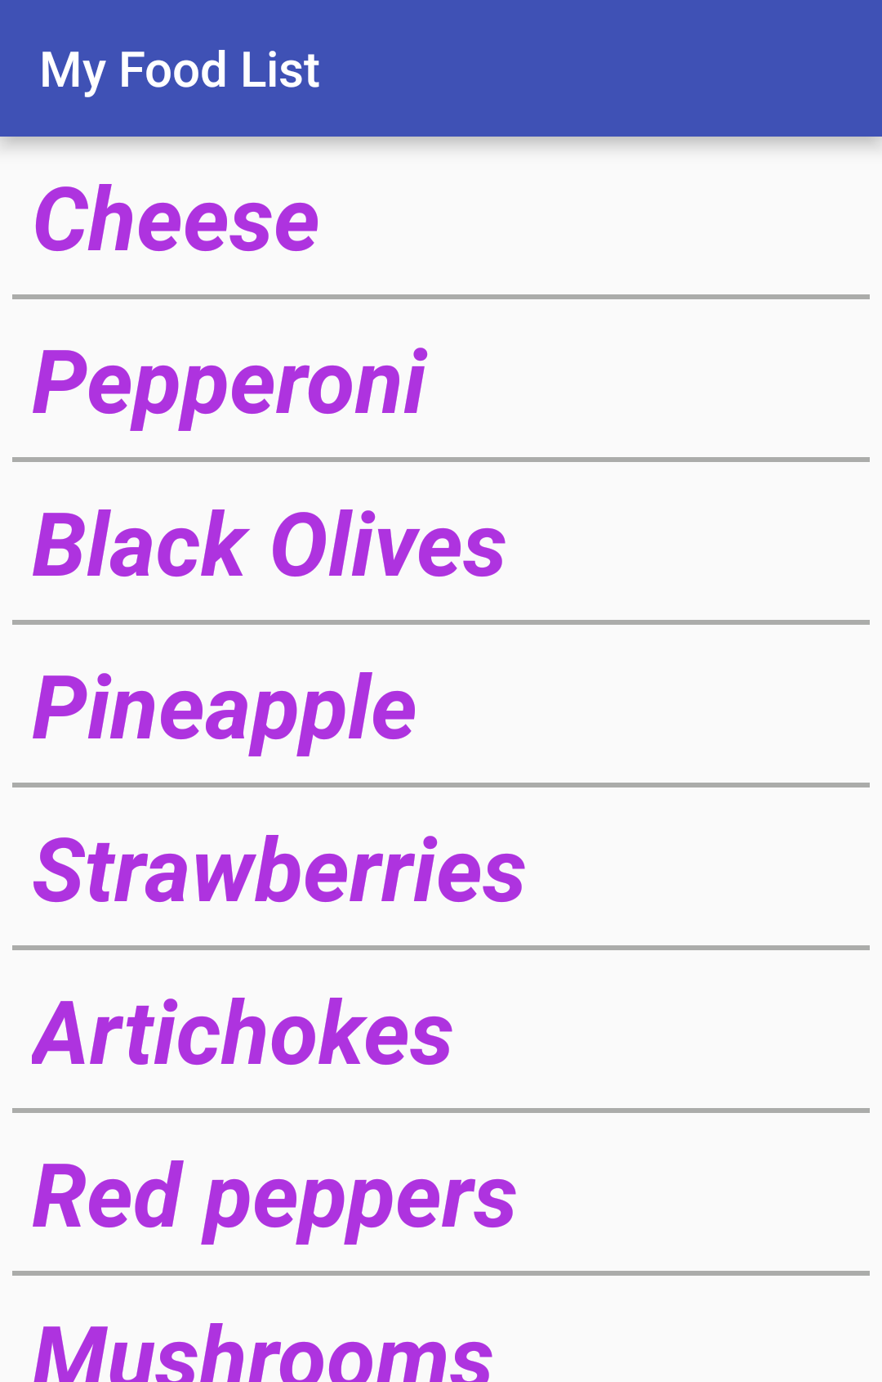
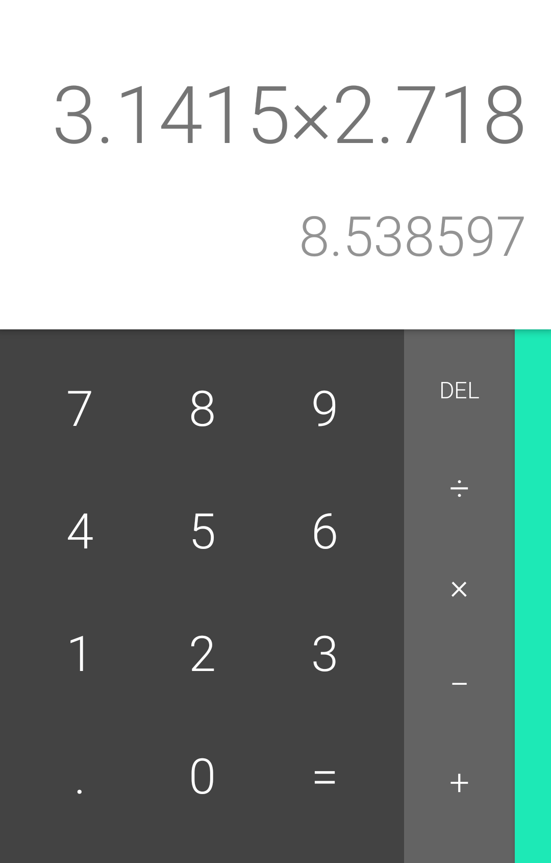
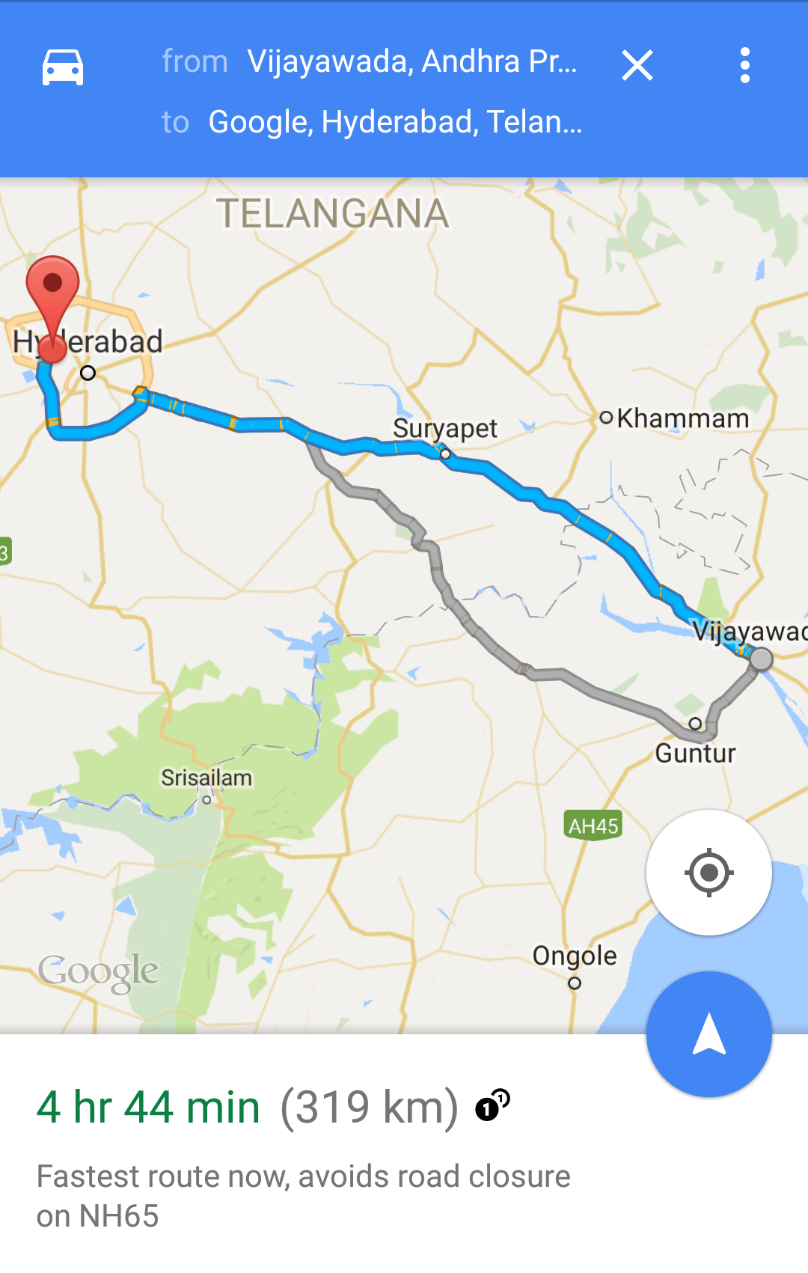
Examples of activities

Slide 14
Apps and activities
Activities are loosely tied together to make up an app
First Activity user sees is typically called "main activity"
Activities can be organized in parent-child relationships in the Android manifest to aid navigation

Slide 15
Layouts and Activities
An Activity typically has a UI layout
Layout is usually defined in one or more XML files
Activity "inflates" layout as part of being created

Slide 16
Implement new activities
Define layout in XML
Define Activity Java class
extends AppCompatActivity
Connect Activity with Layout
Set content view in onCreate()
Declare Activity in the Android manifest

Slide 17
Define layout in XML
<?xml version="1.0" encoding="utf-8"?>
<RelativeLayout
xmlns:android="http://schemas.android.com/apk/res/android"
android:layout_width="match_parent"
android:layout_height="match_parent">
<TextView
android:layout_width="wrap_content"
android:layout_height="wrap_content"
android:text="Let's Shop for Food!" />
</RelativeLayout>

Slide 18
2. Define Activity Java class
public class MainActivity extends AppCompatActivity {
@Override
protected void onCreate(Bundle savedInstanceState) {
super.onCreate(savedInstanceState);
}
}

Slide 19
3. Connect activity with layout
public class MainActivity extends AppCompatActivity {
@Override
protected void onCreate(Bundle savedInstanceState) {
super.onCreate(savedInstanceState);
setContentView(R.layout.activity_main);
}
}
Resource
is layout
in this XML file

Slide 20
4. Declare activity in Android manifest
MainActivity needs to include intent-filter to start from launcher
<activity android:name=".MainActivity">
<intent-filter>
<action android:name="android.intent.action.MAIN" />
<category
android:name="android.intent.category.LAUNCHER" />
</intent-filter>
</activity>

Slide 21
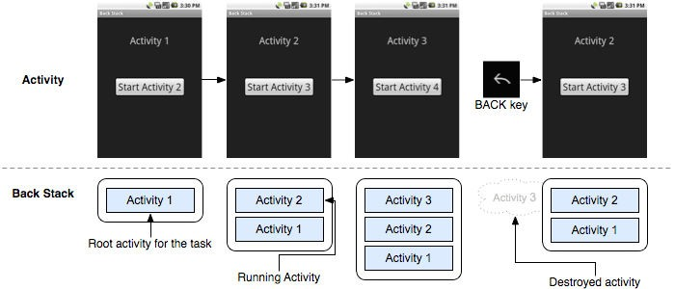
Activity lifecycle and state
The set of states an Activity can be in during its lifetime, from when it is created until it is destroyed
More formally:
A directed graph of all the states an Activity can be in, and the callbacks associated with transitioning from each state to the next one
Task Stack
Phillips, Bill, and Brian Hardy. Android Programming: The Big Nerd Ranch Guide. Pearson Education, 2013.

Slide 22
Activity states and Mobile app visibility
Created (not visible yet)
Started (visible)
Resume (visible)
Paused(partially invisible)
Stopped (hidden)
Destroyed (gone from memory)
State changes are triggered by user action, configuration changes such as device rotation, or system action

Slide 23
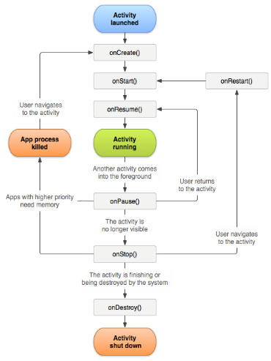
Callbacks and when they are called
onCreate(Bundle savedInstanceState) - static initialization
onStart() - when Activity (screen) is becoming visible
onRestart() - called if Activity was stopped (calls onStart())
onResume() - start to interact with user
onPause() - about to resume PREVIOUS Activity
onStop() - no longer visible, but still exists and all state info preserved
onDestroy() - final call before Android system destroys Activity

Slide 24
Corresponding life cycle methods
protected void onCreate()
protected void onStart()
protected void onResume()
protected void onPause()
protected void onRestart()
protected void onStop()
protected void onDestroy()

Slide 25
Corresponding life cycle methods
onCreate()
Called when Activity is ﬁrst being created, and Setup global state
Inﬂate UI views
Conﬁgure views as necessary
@Override
public void onCreate(Bundle savedInstanceState) { super.onCreate(savedInstanceState); // The activity is being created.
}
onRestart()
Called if the Activity has been stopped and is about to be started again
Typical actions
Read cached state
@Override
protected void onRestart() {
super.onRestart(); // The activity is between stopped and started.
}

Slide 26
Corresponding life cycle methods
onStop()
@Override
protected void onStop() {
super.onStop();
// The activity is no longer visible
// it is now "stopped"
}
Activity is no longer visible to user
But may be restarted later
Typical actions
Cache state
onDestroy()
@Override
protected void onDestroy() {
super.onDestroy();
// The activity is about to be destroyed.
}
Activity is about to be destroyed
Typical actions
Save persistent state

Slide 27
Corresponding life cycle methods
onResume()
@Override
protected void onResume() {
super.onResume();
// The activity has become visible
// it is now "resumed“
}
About to start interacting with user
Typical actions
Start foreground‐only behaviors
onPause()
Focus about to switch to another Activity
Typical actions
@Override
protected void onPause() {
super.onPause();
// Another activity is taking focus
// this activity is about to be "paused"
}
Shutdown foreground‐only behaviors

Slide 28
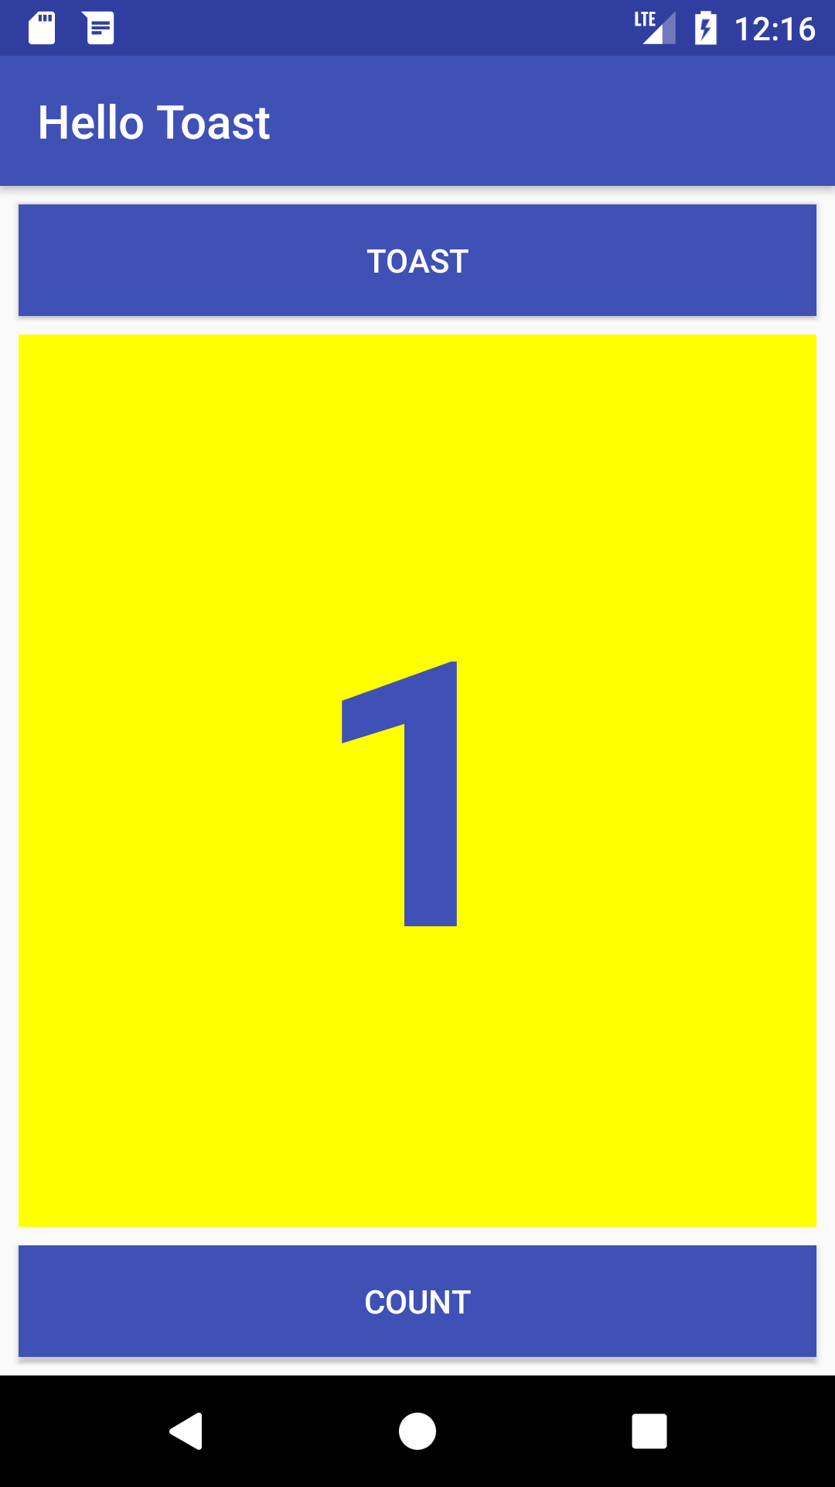
Everything you see is a view
If you look at your mobile device,
every user interface element that you see is a View.
Views

Slide 29
What is a view?
View subclasses are basic user interface building blocks
Display text (TextView class), edit text (EditText class)
Buttons (Button class), menus, other controls
Scrollable (ScrollView, RecyclerView)
Show images (ImageView)
Group views (ConstraintLayout and LinearLayout)

Slide 30


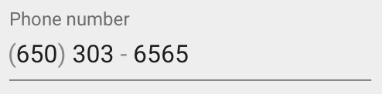

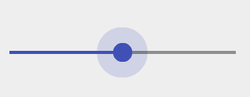
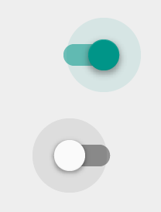
Examples of view subclasses
Button
EditText
Slider
CheckBox
RadioButton
Switch

Slide 31
View attributes
Color, dimensions, positioning
May have focus (e.g., selected to receive user input)
May be interactive (respond to user clicks)
May be visible or not
Relationships to other views

Slide 32
Create views and layouts
Android Studio layout editor: visual representation of XML
XML editor
Java code

Slide 33
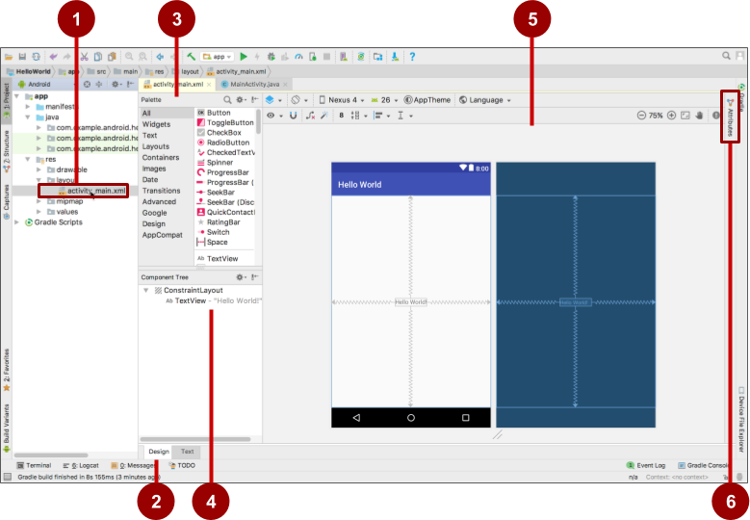
Android Studio layout editor
XML layout file
Design and Text tabs
Palette pane
Component Tree
Design and blueprint panes
Attributes tab

Slide 34
View defined in XML
<TextView
android:id="@+id/show_count"
android:layout_width="match_parent"
android:layout_height="wrap_content"
android:background="@color/myBackgroundColor"
android:text="@string/count_initial_value"
android:textColor="@color/colorPrimary"
android:textSize="@dimen/count_text_size"
android:textStyle="bold"
/>

Slide 35
View attributes in XML
android:<property_name>="<property_value>"
Example: android:layout_width="match_parent"
android:<property_name>="@<resource_type>/resource_id"
Example: android:text="@string/button_label_next"
android:<property_name>="@+id/view_id"
Example: android:id="@+id/show_count"

Slide 36
Create View in Java code
context
In an Activity:
TextView myText = new TextView(this);
myText.setText("Display this text!");

Slide 37
What is the context?
Context is an interface to global information about an application environment
Get the context:
Context context = getApplicationContext();
An Activity is its own context: TextView myText = new TextView(this);

Slide 38
ViewGroup contains "child" views
ConstraintLayout: Positions UI elements using constraint connections to other elements and to the layout edges
ScrollView: Contains one element and enables scrolling
RecyclerView: Contains a list of elements and enables scrolling by adding and removing elements dynamically

Slide 39
ViewGroups for layouts
Layouts
are specific types of ViewGroups (subclasses of ViewGroup)
contain child views
can be in a row, column, grid, table, absolute

Slide 40




Common Layout Classes
LinearLayout
ConstraintLayout
GridLayout
TableLayout

Slide 41
Common Layout Classes
ConstraintLayout: Connect views with constraints
LinearLayout: Horizontal or vertical row
RelativeLayout: Child views relative to each other
TableLayout: Rows and columns
FrameLayout: Shows one child of a stack of children
Absolute Layout: enables you to specify the exact location of its children.
List View Layout : displays a list of scrollable items.
Grid View Layout : displays items in a two-dimensional, scrollable grid

Slide 42
Class hierarchy vs. layout hierarchy
View class-hierarchy is standard object-oriented class inheritance
For example, Button is-a TextView is-a View is-an Object
Superclass-subclass relationship
Layout hierarchy is how views are visually arranged
For example, LinearLayout can contain Buttons arranged in a row
Parent-child relationship

Slide 43
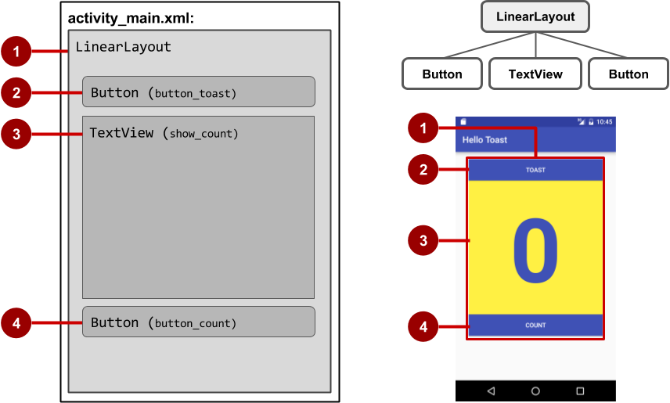
View hierarchy and screen layout

Slide 44
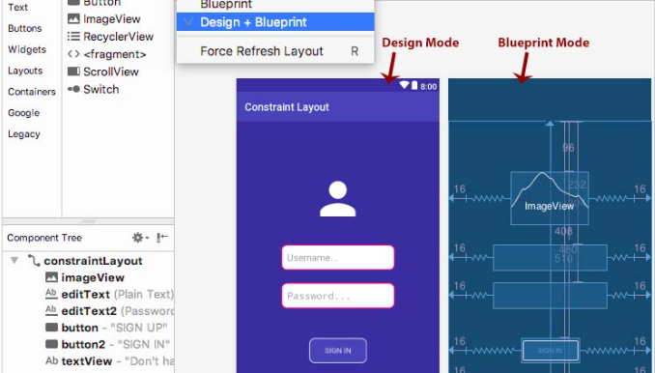
ConstraintLayout

Slide 45
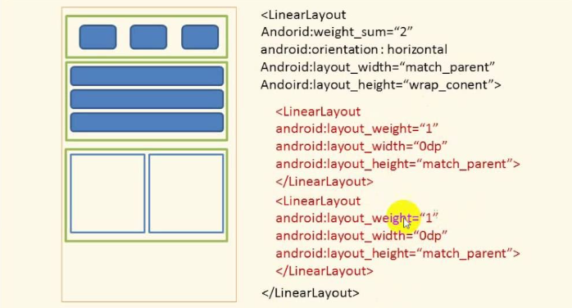
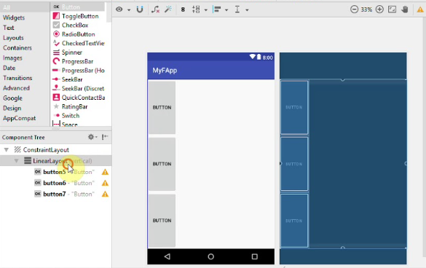
LinearLayout
LinearLayout: vertical
LinearLayout: horizontal

Slide 46
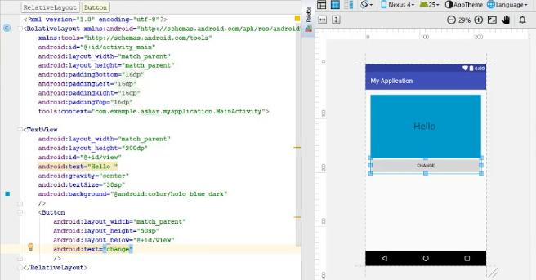
RelativeLayout

Slide 47
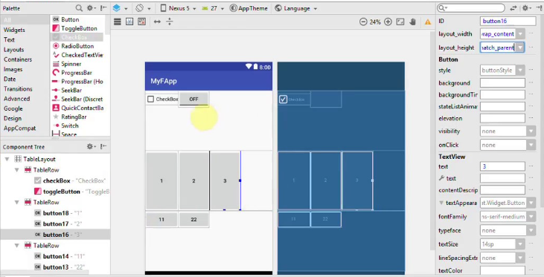
TableLayout

Slide 48
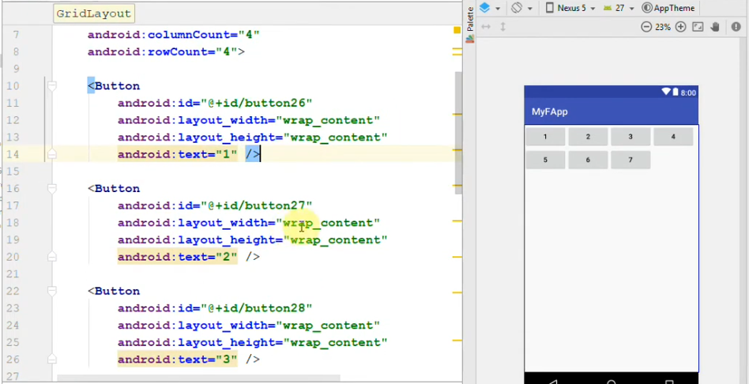
GridLayout

Slide 49
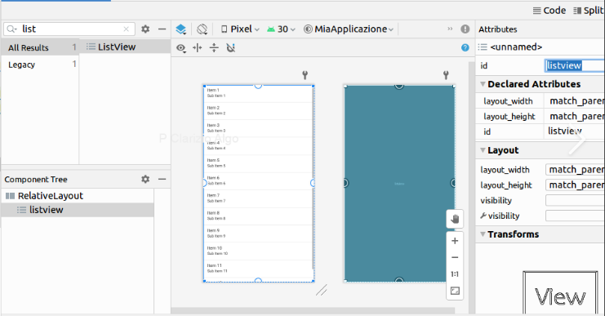
List View Layout

Slide 50
Layout created in XML
<LinearLayout
android:orientation="vertical"
android:layout_width="match_parent"
android:layout_height="match_parent">
<Button
... />
<TextView
... />
<Button
... />
</LinearLayout

Slide 51
Layout created in Java Activity code
LinearLayout linearL = new LinearLayout(this);
linearL.setOrientation(LinearLayout.VERTICAL);
TextView myText = new TextView(this);
myText.setText("Display this text!");
linearL.addView(myText);
setContentView(linearL);

Slide 52
Set width and height in Java code
Set the width and height of a view:
LinearLayout.LayoutParams layoutParams =
new Linear.LayoutParams(
LayoutParams.MATCH_PARENT, LayoutParams.MATCH_CONTENT);
myView.setLayoutParams(layoutParams);

Slide 53
The layout editor with ConstraintLayout
Connect UI elements to parent layout
Resize and position elements
Align elements to others
Adjust margins and dimensions
Change attributes

Slide 54
What is ConstraintLayout?
Default layout for new Android Studio project
ViewGroup that offers flexibility for layout design
Provides constraints to determine positions and alignment of UI elements
Constraint is a connection to another view, parent layout, or invisible guideline

Slide 55
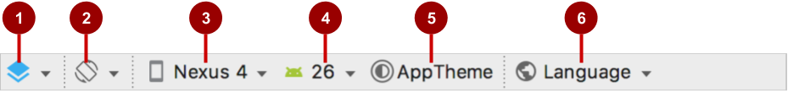
Layout editor main toolbar
Select Design Surface: Design and Blueprint panes
Orientation in Editor: Portrait and Landscape
Device in Editor: Choose device for preview
API Version in Editor: Choose API for preview
Theme in Editor: Choose theme for preview
Locale in Editor: Choose language/locale for preview

Slide 56
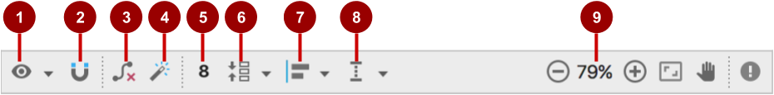
ConstraintLayout toolbar in layout editor
Show: Show Constraints and Show Margins
Autoconnect: Enable or disable
Clear All Constraints: Clear all constraints in layout
Infer Constraints: Create constraints by inference
Default Margins: Set default margins
Pack: Pack or expand selected elements
Align: Align selected elements
Guidelines: Add vertical or horizontal guidelines
Zoom controls: Zoom in or out

Slide 57
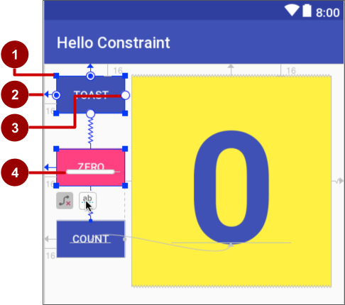
ConstraintLayout handles
Resizing handle
Constraint line and handle
Constraint handle
Baseline handle

Slide 58

Align elements by baseline
Click the baseline constraint button
Drag from baseline to other element's baseline

Slide 59
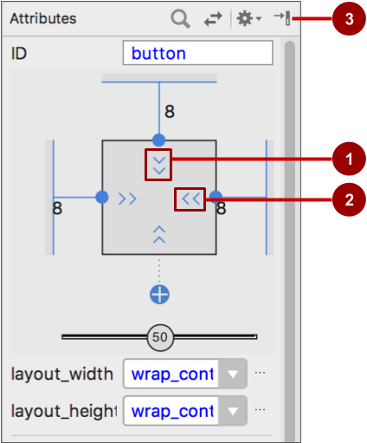
Attributes pane view inspector
Vertical view size control specifies layout_height
Horizontal view size control specifies layout_width
Attributes pane close button

Slide 60

Layout_width and layout_height
layout_width and layout_height change with size controls
match_constraint: Expands element to fill its parent
wrap_content: Shrinks element to enclose content
Fixed number of dp (density-independent pixels)

Slide 61
Set attributes example: TextView

Slide 62
Event Handlers
Methods that do something in response to a click
A method, called an event handler, is triggered by a specific event and does something in response to the event

Slide 63
Attach in XML and implement in Java
Attach handler to view in XML layout:
android:onClick="showToast"
Implement handler in Java activity:
public void showToast(View view) {
String msg = "Hello Toast!";
Toast toast = Toast.makeText(
this, msg, duration);
toast.show();
}
}

Slide 64
Alternative: Set click handler in Java
final Button button = (Button) findViewById(R.id.button_id);
button.setOnClickListener(new View.OnClickListener() {
public void onClick(View v) {
String msg = "Hello Toast!";
Toast toast = Toast.makeText(this, msg, duration);
toast.show();
}
});

Slide 65
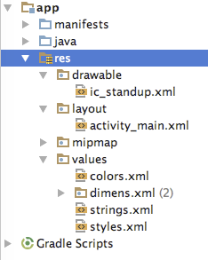
Where are the resources in your project?
resources and resource files
stored in res folder

Slide 66
Refer to resources in code
Layout:
R.layout.activity_main
setContentView(R.layout.activity_main);
View:
R.id.recyclerview
rv = (RecyclerView) findViewById(R.id.recyclerview);
String:
In Java: R.string.title
In XML: android:text="@string/title"

Slide 67
Measurements
Density-independent Pixels (dp): for Views
Scale-independent Pixels (sp): for text
Don't use device-dependent or density-dependent units:
Actual Pixels (px)
Actual Measurement (in, mm)
Points - typography 1/72 inch (pt)

Slide 68
Any Questions?

